Slide 1


Basic Details of the Team and Problem Statement
Ministry/Organization Name : Department of Empowerment of Persons with Disabilities (Divyangjan) ,
Ministry of Social Justice and Empowerment
PS Code : RK758
Problem Statement Title : Enabling Communication Strategies For Persons With Hearing Impairment
Team Name : We Hear You
Institute Code : 1-15937511
Institute Name : Mahatma Gandhi Mission’s College Of Engineering , Nanded
Theme Name : Smart Education

Slide 2



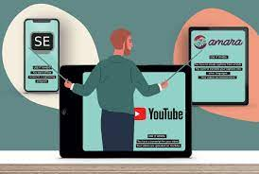
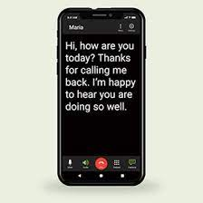
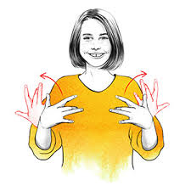
Our Solution
Flowchart
DESCRIPTION :
We are going to develop an android application which will perform open and close captioning in videos , real time call captioning over a phone line and Indian sign Language animated model. This application will be a solution for communication with Persons having Hearing Impairment …!
NORMAL PERSON
Speech [ Recorded Audio / Video]
Live Telephone Calling [Speech]
Speech / Text
C
O
N
V
E
R
S
I
O
N
Speech to Text
+
Subtitles for Videos
Real Time Call Captioning
Indian Sign Language Through Animated Avatar
Text
Tran-scripted Text
Animated Sign Language
HEARING IMPAIRED PERSON

Slide 3
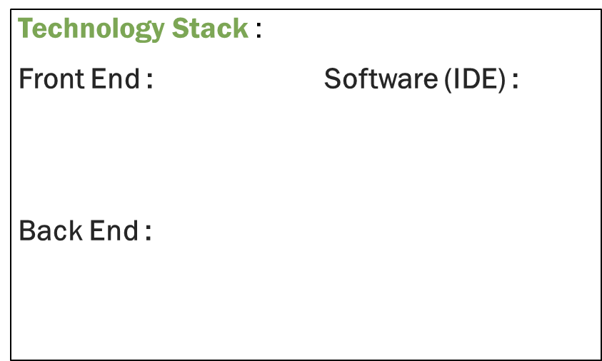








Further Details
Use Cases :
Independence in communication :
It will help to remove the barriers in communication between normal humans and a deaf persons.
Our application’s end user can be Deaf and Dumb people as well as a normal person.
If a normal person is speaking to a deaf person who is talking in sign language so he can use our application’s feature of sign language to text convertor.
Dependencies :
Features : :
Convert speech to text .
Provides real-time call to text .
Provides Subtitles for videos .
In live video call , Convert text / audio to animated sign language Vice – versa.
Provides facility to send text messages on telephone
Our mobile app depends on the support provided by the government to spread awareness about this application and advantages.
Microphone , Media / Storage , Manage Calls permissions needs to be accessed throughout the devices.
Link Of work done till now :
https://github.com/WeHearYou

Slide 4


Team Member Details
Team Member 1 Name : Martand Maheshrao Pangrekar
Branch : BTech Stream : ETC Year : IV
Team Member 2 Name : Purushottamsingh Rajpalsingh Jakrewale
Branch : BTech Stream : ETC Year : IV
Team Member 3 Name : Avishkar Anil Kulkarni
Branch : BTech Stream : ETC Year : IV
Team Mentor Name : Mr. D. J. Tuptewar
Category : Academic Expertise : Image Processing Domain Experience (in years) : 10
VLSI Embedded System

